Slide 1
Autoencoders and CNN
(UNIT-3)
Introduction to NN and DNN
Dr. Supriya Patil

Slide 2
Introduction

Slide 3
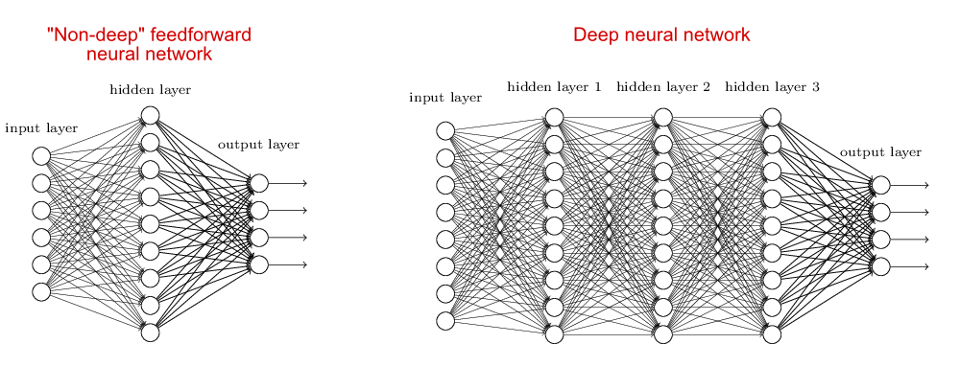
ANN and DNN

Slide 4
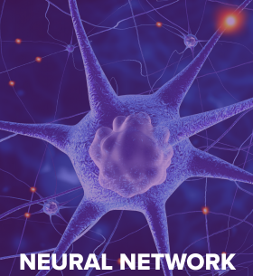
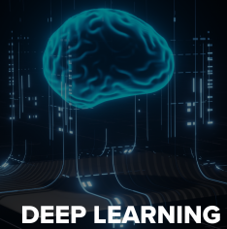
Difference between ANN and DNN
Definition | A neural network is a model of neurons inspired by the human brain. It consists of many neurons and their connections. A neuron can be represented as an activation function with several inputs and one output | DNN are distinguished from NN on the basis of their depth, which is the number of hidden layers through which the data is passed. DNNs have more nodes in all the hidden layers.
Components | Neurons. Connections, weights, activation functions and learning rate. | Mother board (PCI-e lanes.), GPU, TPU, huge RAM, large Power supply unit.
Time taken | Less time require to train the network | More time required to train the network
Interpretability | Less accuracy | Better accuracy
Performance | Shows low performance | Shows better performance

Slide 5
Different Architectures | Single layer feed forward network: A common type of neural network with an input layer, hidden layer and output layer. Recurrent Neural Network: In RNN data is processed in a sequence. It uses their internal state or memory to process sequences of inputs. Symmetrically Connected NN: They are similar to Recurrent NN with connections between the units symmetrical. I.e They have same weight values in both the directions. | Unsupervised Pretrained networks: They are pretrained like Autoencoders. Convolutional Neural Networks: This is the network for images, videos etc. Recurrent Neural networks: It is for parallel and sequence information.
Some more definitions | It is a structure consisting of ML algorithms wherein the artificial neurons make the core computational unit that focuses on uncovering the underlying patterns or connections within a dataset, just like the human brain does while decision making. | It is a branch of Machine Learning that leverages a series of nonlinear processing units comprising multiple layers for feature transformation and extraction. It has several layers of artificial neural networks that carry out the ML process. The first layer of the neural network processes the raw data input and passes the information to the second layer. The second later then processes that information further by adding additional information (for example, user’s IP address) and passes it to the next layer. This process continues throughout all layers of the Deep Learning network until the desired result is achieved.
 | Neural Networks use neurons to transmit data in the form of input values and output values through connections | Deep Learning is associated with the transformation and extraction of feature which attempts to establish a relationship between stimuli and associated neural responses present in the brain.
1. https://www.upgrad.com/blog/deep-learning-vs-neural-networks-difference-between-deep-learning-and-neural-networks/
2. https://smartboost.com/blog/deep-learning-vs-neural-network/

Slide 6
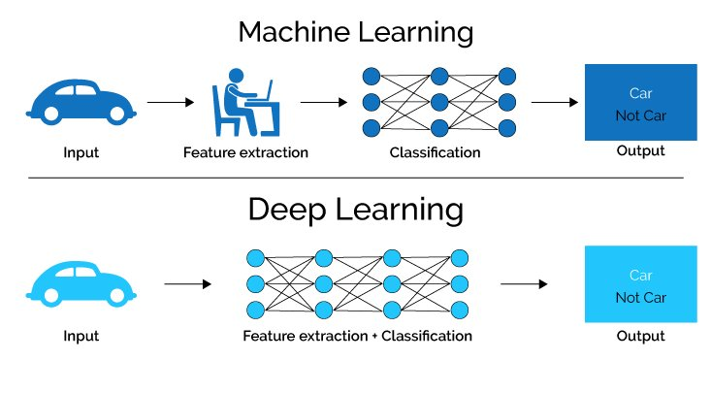
Difference between ANN and DNN
Deep-learning networks perform automatic feature extraction without human intervention, unlike most traditional machine-learning algorithms. Given that feature extraction is a task that can take teams of data scientists years to accomplish, deep learning is a way to circumvent the chokepoint of limited experts. It augments the powers of small data science teams, which by their nature do not scale.
When training on unlabeled data, each node layer in a deep network learns features automatically by repeatedly trying to reconstruct the input from which it draws its samples, attempting to minimize the difference between the network’s guesses and the probability distribution of the input data itself. Restricted Boltzmann machines, for examples, create so-called reconstructions in this manner.

Slide 7
Types of DNN
Recurrent Neural Networks:
Deep recurrent networks are capable of solving problems related to audio data, text data, and time-series data.
Recurrent neural networks capture sequential information available in the input data.
Tasks that use RNN: Natural Language Processing
Time Series Data,
Machine Translations,
Speech Recognition,
Image Caption Generation
Convolutional Neural Networks:
The CNN based models in Deep Neural Networks are used in video and image processing.
Filters or kernels are the building blocks of CNN
By using conventional operations kernels extract relevant and correct features from the input data.
Tasks that use CNN: Image Classification, Object Detection,
Image Segmentation, Facial Recognition,
Image Caption Generation

Slide 8
Other most popular DNN algorithms
Autoencoders
LSTMS: Long Short-Term Memory Networks
MLPs: Multilayer Perceptron
RBFNs: Radial Basis Function Networks
DBNs: Deep Belief Networks
GANs: Generative Adversarial Networks
RBMs: Restricted Boltzmann Machines
SOMs: Self Organizing Maps

Slide 9
Applications of Deep Neural Network
Few examples of common daily life digital products based on Deep Learning are the popular virtual assistants like:
Siri/Alexa/Google Assistant,
The suggestion to tag your friend in a Facebook photo uploaded,
Autonomous driving in Tesla,
The cat filter in Snapchat,
Product recommendations in Amazon and Netflix,
The recent viral photo apps like FaceApp and Prisma,
and the list goes on.

Slide 10
Autoencoders

Slide 11

Machine learning and feature
Introduction to Autoencoders
Some information
AI algorithm
Something useful result
Image, audio, text
Some action, description of text and so on

Slide 12
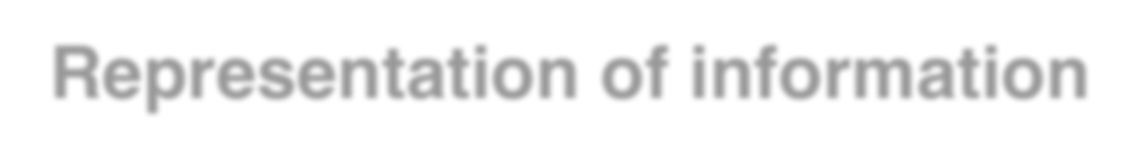

Representation of information
Real world object can be represented as some feature in computer
In case of human:
name
age
gender
nationality
In case of image:
pixel
In case of audio:
signal

Slide 13

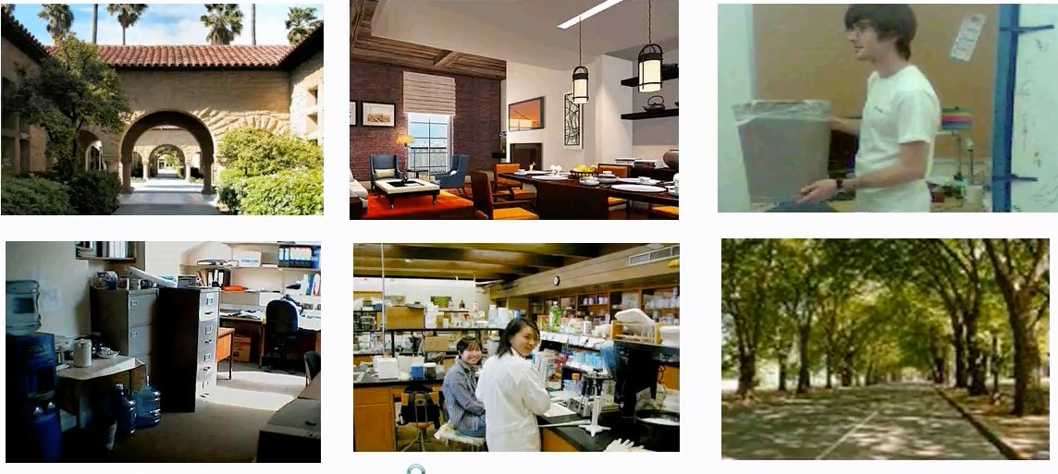
Feature
image source : https://www.youtube.com/watch?v=vfnxKO2rMq4
However, we don’t know which representation is better
Find a better way to represent images than pixels

Slide 14
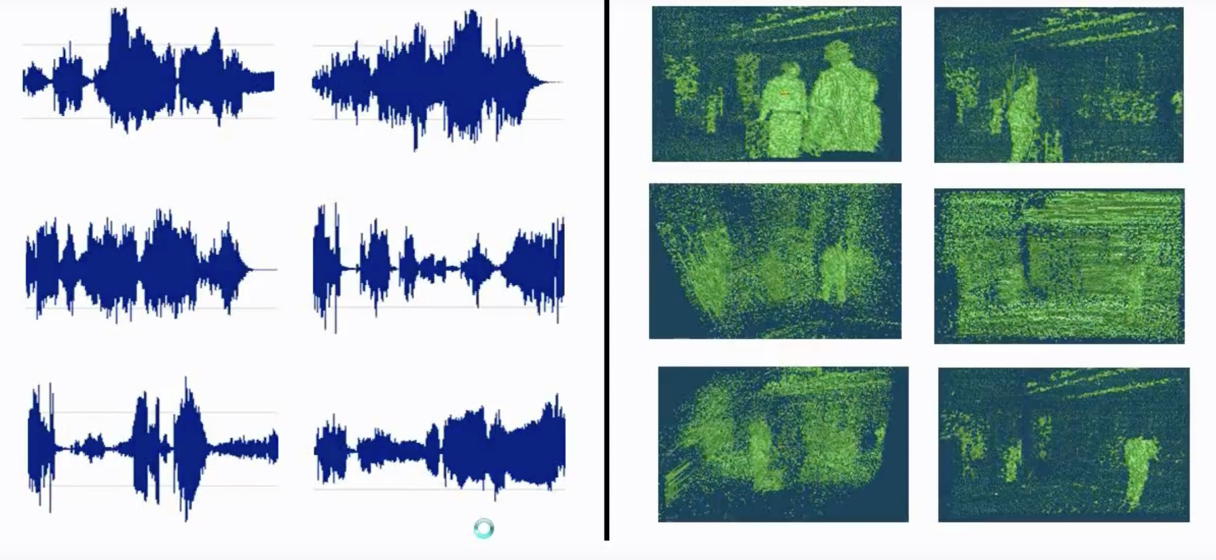
Feature
However, we don’t know which representation is better
Find a better way to represent audio, 3d range scans

Slide 15
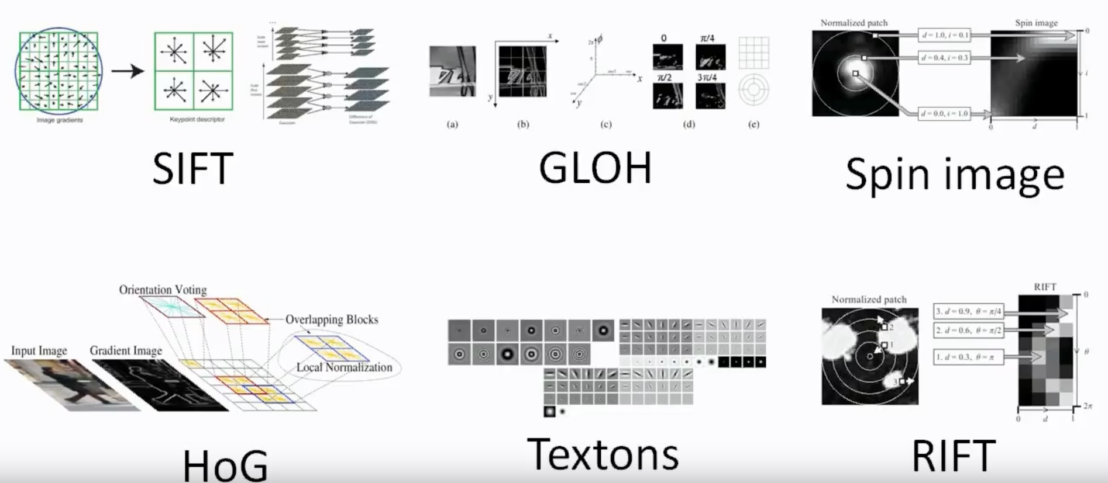
Feature
Thousands of Engineers have spent the years or decades to find how to represent data exists in real world

Slide 16
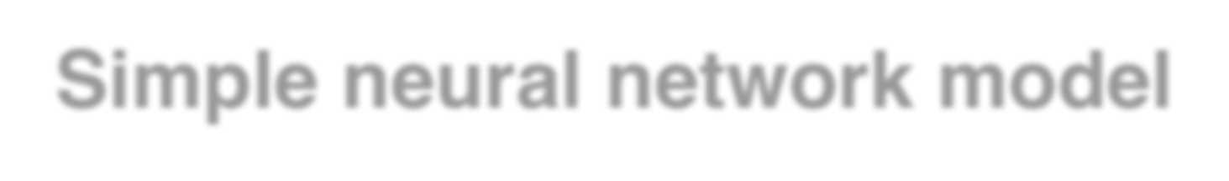

Simple neural network model
Input 𝐱
𝒚 = 𝒇(𝑾𝒙 + 𝒃)

Slide 17
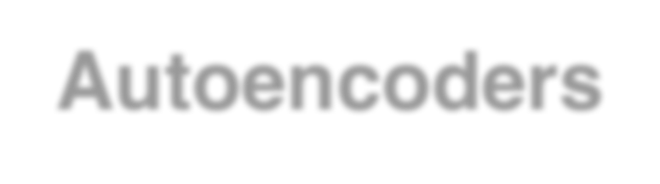
Autoencoders
Neural net with symmetry weights
Encoder Decoder
𝒙_{𝟏}
𝒙._{𝟏}
𝒙_{𝟐}
𝒙._{𝟐}
𝒙_{𝟑}
𝒙._{𝟑}
Input 𝒙
Output 𝒙.

Slide 18
Autoencoders
Encoder yields compression of input data
Encoder
Input 𝑿
𝒚 = 𝒇(𝑾𝒙 + 𝒃)

Slide 19
Autoencoders
Decoder reconstructs input data
Decoder
𝒙._{𝟏}
𝒙._{𝟐}
𝒙._{𝟑}
Output 𝒙.
𝒙. = 𝒈(𝒚𝑾¹ + 𝒃)

Slide 20
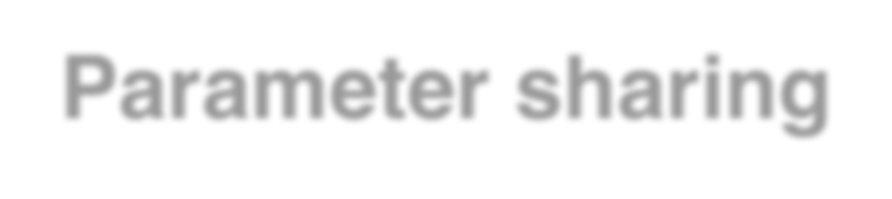
Parameter sharing
It is possible to design autoencoder as 𝑾¹ = 𝑾^{𝑻}
Exactly same value
𝒙_{𝟏}
𝒙._{𝟏}
𝒙_{𝟐}
𝒙._{𝟐}
𝒙_{𝟑}
𝒙._{𝟑}
Input 𝒙
Output 𝒙.

Slide 21

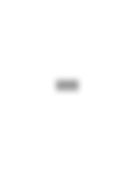
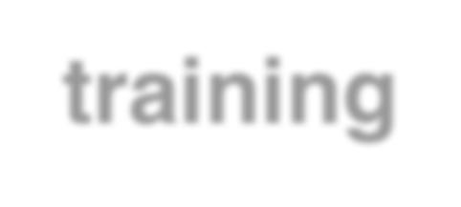
Pre-training
Train autoencoder and replace decoder
Encoder Decoder
𝒙_{𝟏}
𝒙._{𝟏}
𝒙_{𝟐}
𝒙._{𝟐}
𝒙_{𝟑}
𝒙._{𝟑}
Input 𝒙
Output 𝒙.

Slide 22
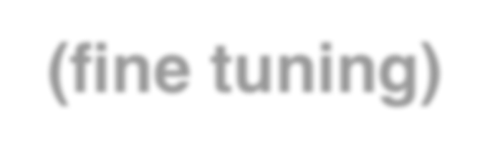
Pre-training (fine tuning)
Train autoencoder and replace decoder
Encoder
New output layer
𝒙_{𝟏}
𝒚_{𝟏}
𝒚_{𝟐}
𝒙_{𝟐}
𝒚_{𝟑}
𝒙_{𝟑}
𝒚_{𝟒}
Input 𝒙
Output 𝐲

Slide 23
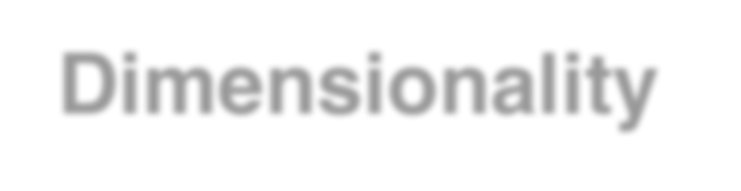

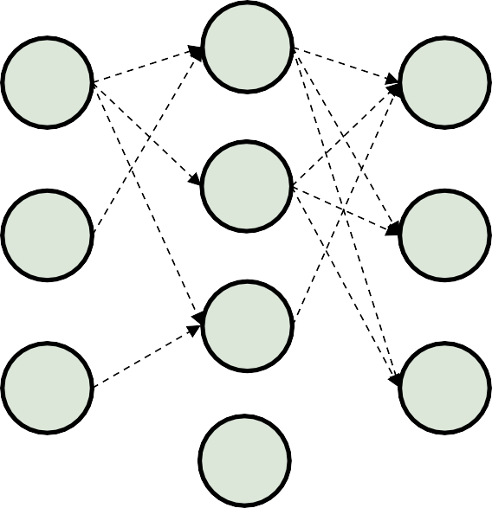
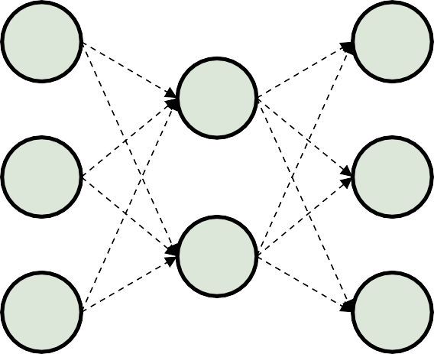
Dimensionality reduction
Undercomplete autoencoder and Overcomplete Autoencoder
For Undercomplete autoencoder - output dimension of encoder is smaller than input dimension and vice versa for Overcomplete autoencoder
𝒙_{𝟏}
𝒙._{𝟏}
𝒙_{𝟏}
𝒙._{𝟏}
𝒙_{𝟐}
𝒙._{𝟐}
𝒙_{𝟐}
𝒙._{𝟐}
𝒙_{𝟑}
𝒙._{𝟑}
𝒙_{𝟑}
𝒙._{𝟑}
Undercomplete
Overcomplete

Slide 24
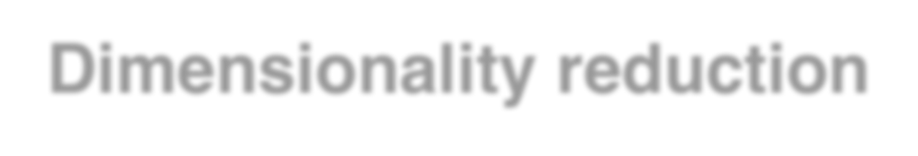
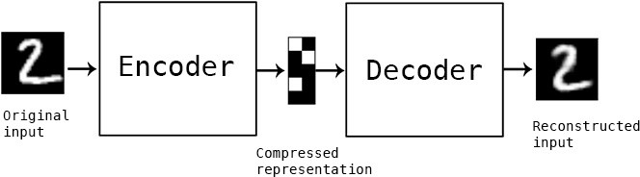
Dimensionality reduction
If autoencoder is undercomplete, encoder has effect of dimensionality reduction
If decoder is undercomplete and linear, encoder has same effect of Principle Component Analysis (PCA)
(Undercomplete)
image source : https://blog.keras.io/building-autoencoders-in-keras.html

Slide 25
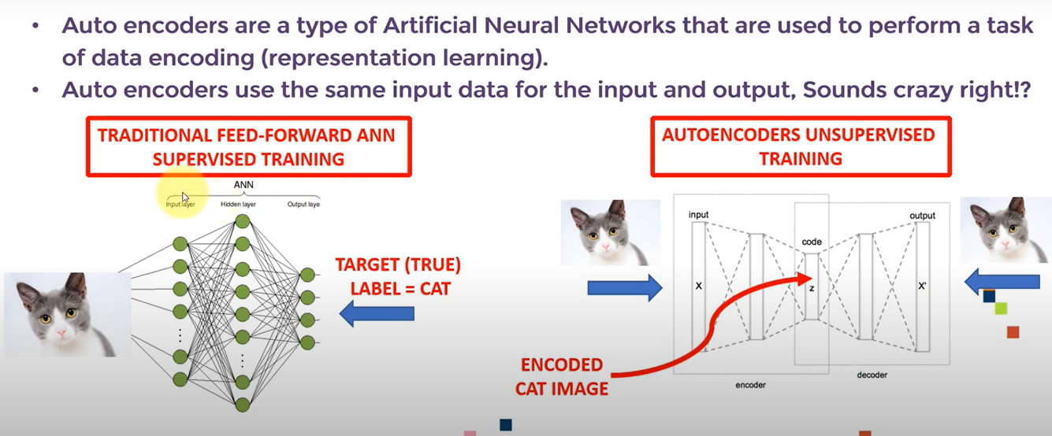
https://www.youtube.com/watch?v=aqaVv3RiNow

Slide 26
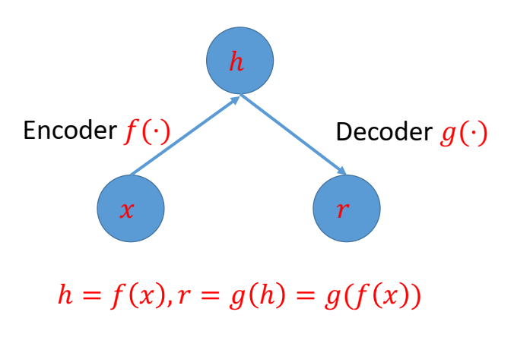
Autoencoder (Network that encodes data on its own)
Autoencoder is a feed forward neural network trained by using unsupervised learning.
Neural networks trained to attempt to copy its input to its output.
It’s a simple network that transforms inputs into outputs with minimum possible errors.
Autoencoder is an unsupervised machine learning algorithm that applies back propagation setting target output values as its inputs.
• It contain two parts:
Encoder: map the input to a hidden representation. An encoder function h = f(x)
Decoder: map the hidden representation to the output (reconstructs the input). The decoder function r = g(h).
Architecture

Slide 27
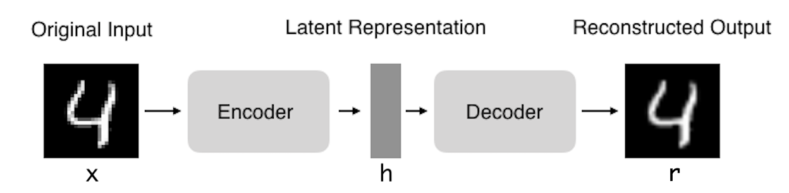
Autoencoder
Encoder: Compress input into a latent-space of usually smaller dimension. h = f(x)
Decoder: Reconstruct input from the latent space. r = g(f(x)) with r as close to x as possible
For image of size m*n---- size of input vector (m*n+1) [1 for bias], size of hidden layer (required compressed size), size of output (m*n).

Slide 28
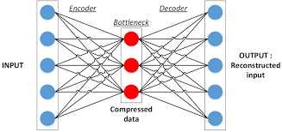
Autoencoder
It basically has three layers: input, hidden (Bottleneck) and output layer
Autoencoder should be sensitive enough to a input to provide faithful reconstruction of the input and
not sensitive enough to memorise or overfit the training data.
To satisfy both these conflicting requirements Loss function can be designed properly.
Loss function = L(X, X’) + Regularizer
1st term is used for minimisation of error. It takes care of faithful reconstruction of input (A).
2nd term takes care of part B..
X
X’

Slide 29
Autoencoder
The encoder and decoder can be LSTM for time series data or CNN for images
Traditionally, autoencoders were used for dimensionality reduction or feature learning.
An Autoencoder can be divided into two parts
Encoder which maps input into a lower dimensional space and decoder maps back this lower dimensional space into reconstruction space where dimensionality of reconstructed space is same as input space.
Eg: take an image, compress it and reconstruct it, original image back.
In case of Auto encoder it is lossy compression.
When Auto encoder compresses and uncompresses and when it uncompresses it tries to be closer to the input.
The difference between input and output representation is called reconstruction error.
The training objective of Autoencoder is to minimise the error between the input and reconstructed input.
Reconstruction error is given by |x-x’|. Its also called as loss function.
During the course of training the model weights are updated to minimise the reconstruction error.
Eg: Give 6 pixel values as input to Autoencoder
Encoder encodes the signal and at hidden layer
six pixels are compressed to 3 pixels.
Further decoder decodes the information (reconstructs the signal) and at output layer 3 pixels are decoded back to 6 pixels.

Slide 30

Autoencoder
Output is not perfect reconstruction of input. There is a loss of information and its measured using loss function.
Reconstruction loss/Expected logged likelihood of ith data point
Kcullbackliibler divergence between encoder distribution.

Slide 31
Bottleneck Layer
In order to force the network to learn the representation or inner structure of the data and not the identity function, bottleneck layer is introduced in the network. It forces compressed representation of input data.
https://www.v7labs.com/blog/autoencoders-guide
The most important part of the neural network, and ironically the smallest one, is the bottleneck. The bottleneck exists to restrict the flow of information to the decoder from the encoder, thus, allowing only the most vital information to pass through.
Since the bottleneck is designed in such a way that the maximum information possessed by an image is captured in it, we can say that the bottleneck helps us form a knowledge-representation of the input.
Thus, the encoder-decoder structure helps us extract the most from an image in the form of data and establish useful correlations between various inputs within the network.
A bottleneck as a compressed representation of the input further prevents the neural network from memorizing the input and overfitting on the data.
As a rule of thumb, remember this: The smaller the bottleneck, the lower the risk of overfitting.
However— Very small bottlenecks would restrict the amount of information storable, which increases the chances of important information slipping out through the layers of the encoder.

Slide 32
PCA Vs. Autoencoder
Other dimensionality reduction technique: PCA (Principal Component Analysis-Traditional data compression technique) that form a lower-dimensional hyperplane to represent data in a higher-dimensional form without losing information.
However—
PCA can only build linear relationships. As a result, it is put at a disadvantage compared with methods like undercomplete autoencoders that can learn non-linear relationships and, therefore, perform better in dimensionality reduction.
This form of nonlinear dimensionality reduction where the autoencoder learns a non-linear manifold is also termed as manifold learning.
Effectively, if we remove all non-linear activations from an undercomplete autoencoder and use only linear layers, we reduce the undercomplete autoencoder into something that works at an equal footing with PCA.

Slide 33
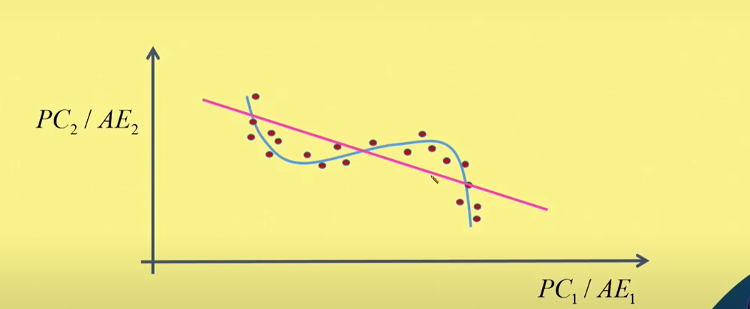
Comparison with PCA
Given a set of data (Red dots in the above image)….
… Its converted into 2 principle components (PC1and PC2) using PCA. Here data is transformed into a plane defined by PC1 and PC2. Its transformed into a straight line (Pink line).
…..For the same data Autoencoders will learn the inner structure present in the data that is not linear and transform it into a non linear structure (Blue curve).
. **If Neural network uses linear activation function, output of PCA and Neural network will be same.
PCA | Autoencoder
It performs only linear transformation | It can perform linear as well as non-linear transformation
It reconstructs the input with significantly higher loss as compared to Autoencoder | It reconstructs the input with significantly lower loss as compared to PCA

Slide 34
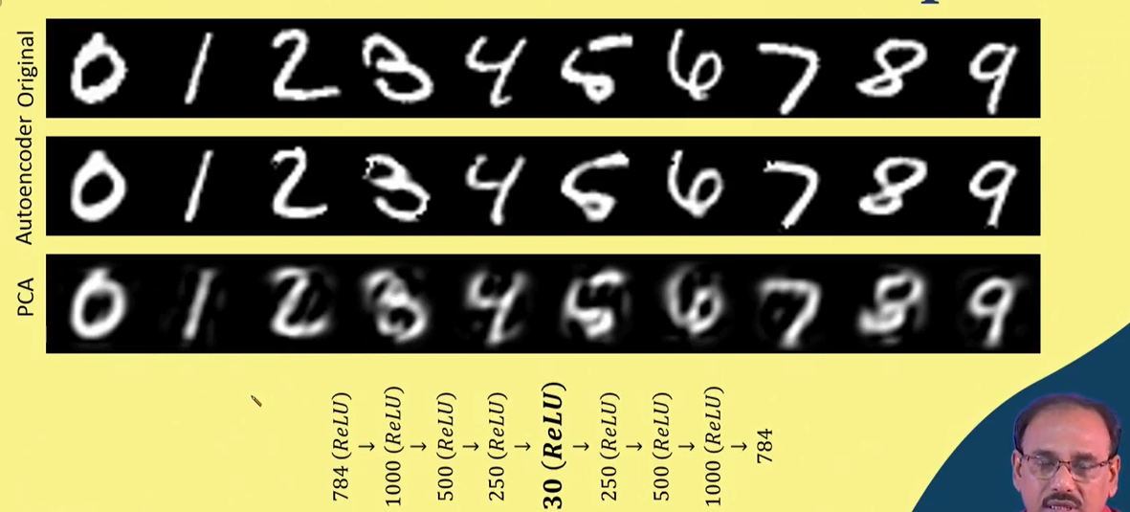
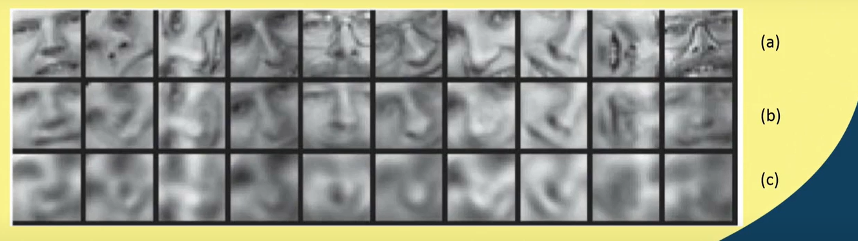
30 Principle components

Slide 35
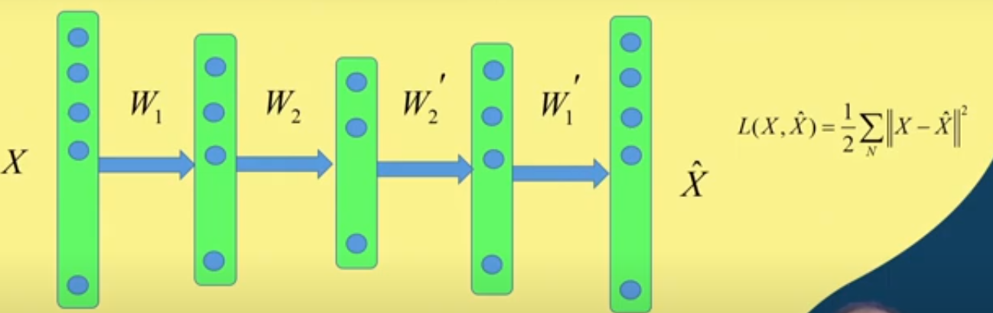
Stacked/Deep Autoencoder
Weight matrices.. Encoder side W1 and W2, Decoder side W1’and W2’
****It includes stacks of hidden layers placed in cascade manner. Depth indicates power of AE
Encoder
Decoder

Slide 36
Training of Stacked/Deep Autoencoder
It includes stacks of hidden layers placed in cascade manner and Depth indicates power of AE.
Weight matrices..
Encoder side W1 and W2 and Decoder side W1’and W2’.
Deeper the network more will be the weight matrices.
Its problematic to handle too many matrices for Deep AE
Memory requirement is higher.
If weight matrices are close to solution weights convergence is faster.
If weight elements are too large finding global minimum is difficult.
If weight elements are too small, convergence becomes too slow.
Therefore training of AE is done in two phases
Pretraining- layer by layer
Fine tuning.
Encoder
Decoder

Slide 37
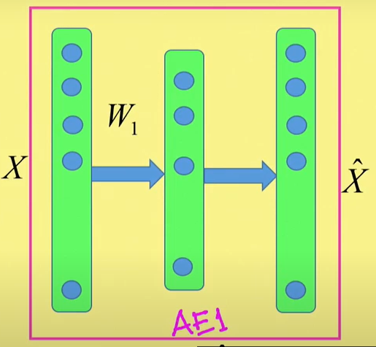
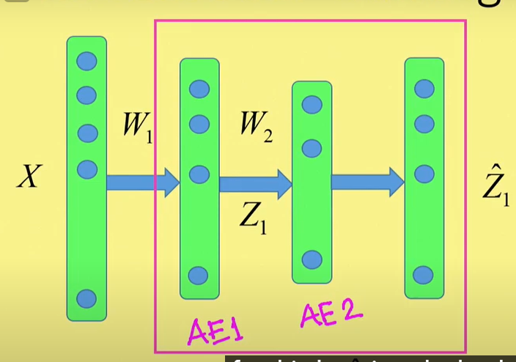
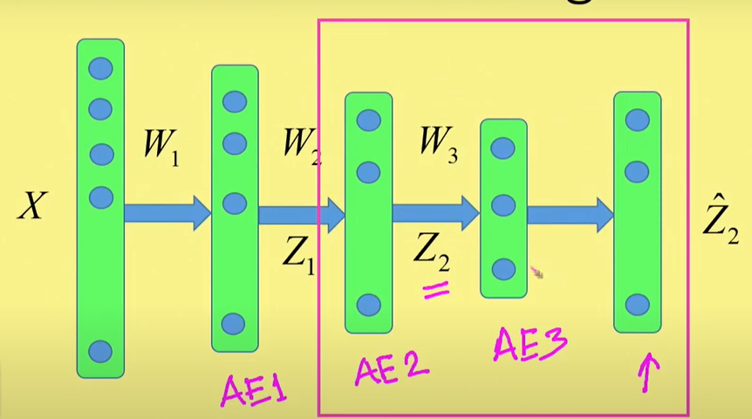
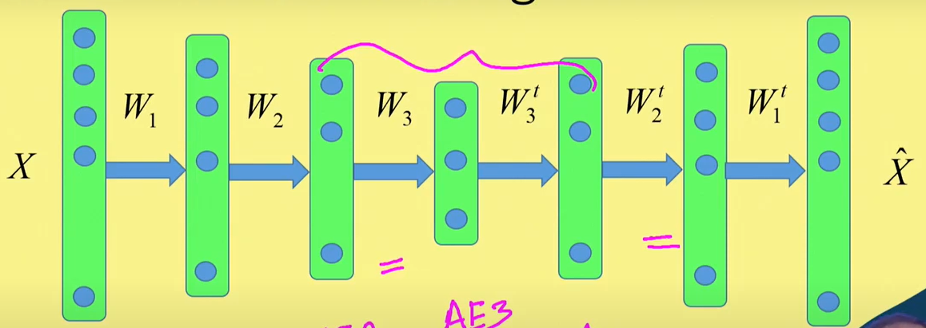
Pretraining: STEP1 STEP2 STEP3
At the end we have pretrained values of W1, W2 and W3.
Fine Tuning:
Decoder weights will be transposes of encoder weights. Train AE by end to end training mechanism.
Because network is pretrained, values of W1, W2 and W3 are closer to solution weights, as a result One or two iterations will be required for fine tuning.
Therefore, convergence will become faster and possibility of reaching global maximum enhances.

Slide 38
Autoencoders:
Important assumption: Components of input data are highly correlated (dependent). As if and only if they are highly correlated to each other then compression and Subsequent reconstruction becomes fruitful.
It removes redundant data i.e. correlated data and preserves only uncorrelated data.
Properties of Autoencoders:
Data-specific: Autoencoders are only able to compress data similar to what they have been trained on.
Lossy: The decompressed outputs will be degraded compared to the original inputs.
Training of Auto Encoder- Hyperparameters (Parameters to be set before training of Auto Encoder):
Code/ Bottleneck layer size: It represents the number of nodes in the middle layer. Smaller size results in more compression.
Number of layers: The autoencoder can consist of as many layers as we want.
Number of nodes per layer: The number of nodes per layer decreases with each subsequent layer of the encoder, and increases back in the decoder. The decoder is symmetric to the encoder in terms of the layer structure. Not compulsory.
Loss function: We either use Mean Squared Error or Binary Cross-Entropy. If the input values are in the range
[0, 1] then we typically use cross-entropy, otherwise, we use the mean squared error.

Slide 39
Autoencoder types
Stochastic Encoders and Decoders
Undercomplete autoencoders
Overcomplete autoencoders
Regularized autoencoders
Sparse autoencoders
Denoising autoencoder
Contractive autoencoders

Slide 40
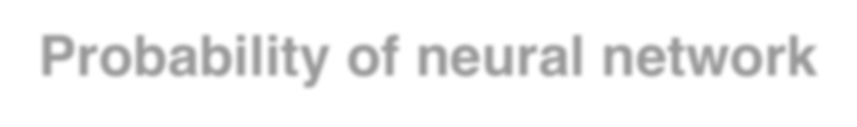
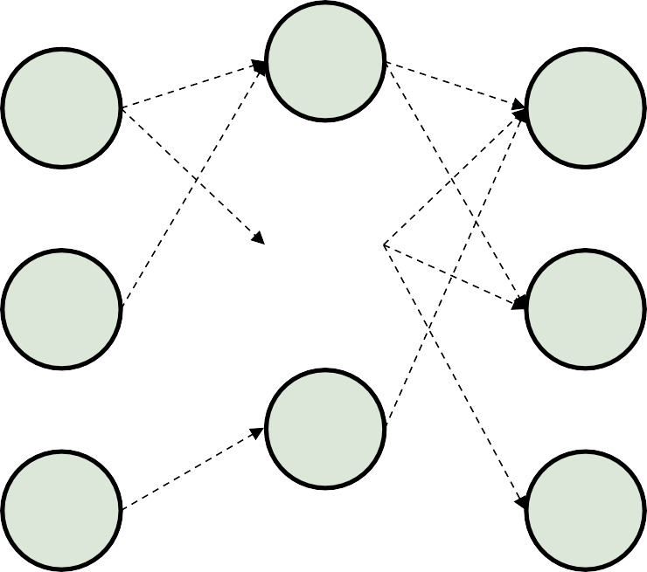
Probability of neural network
Normal feedforward neural network and its probability
- training can be done with minimizing −log(𝒑(𝒚|𝒙))
Stochastic Encoders and Decoders
𝒙_{𝟏}
𝒚_{𝟏}
𝒑(𝒚_{𝟏}|𝒙)
Conditional probability is a measure of the probability of an event occurring, given that another event is already known to have occurred.
𝒑(𝒚𝟏|𝒙) Probability of occurrence of y1 given x has occurred.
𝒙_{𝟐}
𝒚_{𝟐}
𝒑(𝒚_{𝟐}|𝒙)
𝒙_{𝟑}
𝒚_{𝟑}
𝒑(𝒚_{𝟑}|𝒙)

Slide 41
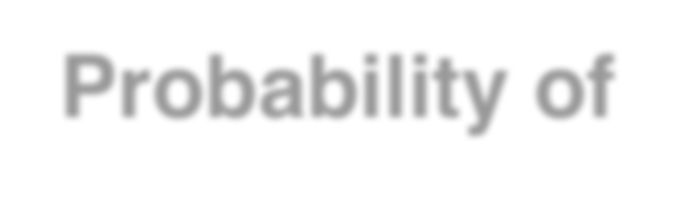
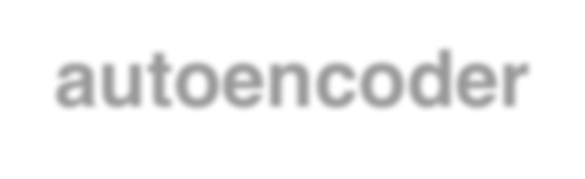
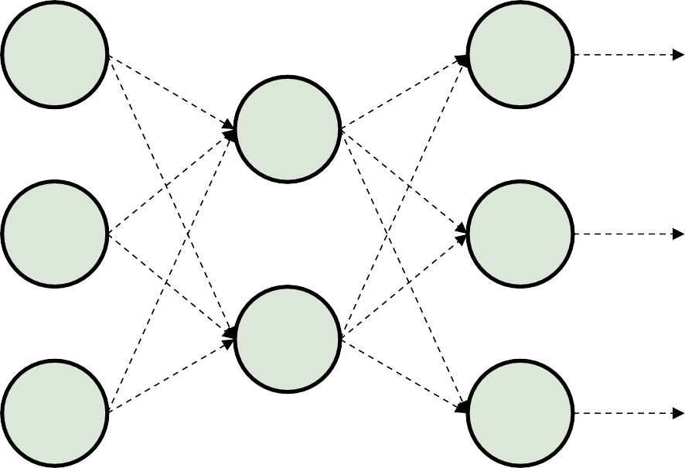
Probability of autoencoder
Autoencoders are just feedforward networks
- the same loss function and output unit types that used for feedforward neural net can be used for autoencoder
𝒙_{𝟏}
𝒙._{𝟏}
𝒑 𝒙_{𝟏} 𝒉
𝒉_{𝟏}
𝒙_{𝟐}
𝒙._{𝟐}
𝒑 𝒙_{𝟐} 𝒉
𝒉_{𝟐}
𝒙_{𝟑}
𝒙._{𝟑}
𝒑 𝒙_{𝟑} 𝒉
Input 𝒙
Output 𝒙.

Slide 42
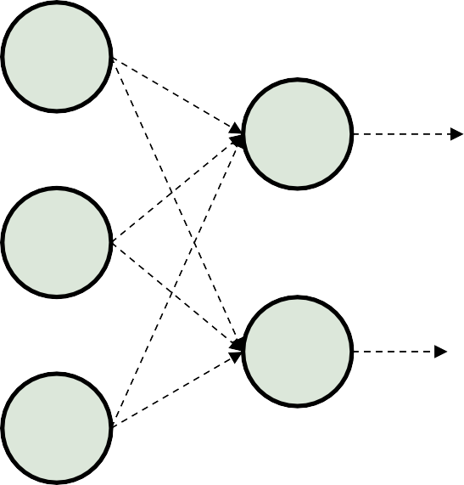
Probability of autoencoder
Encoder
𝒙_{𝟏}
𝒉_{𝟏}
𝒙_{𝟐}
𝒉_{𝟐}
𝒙_{𝟑}

Slide 43
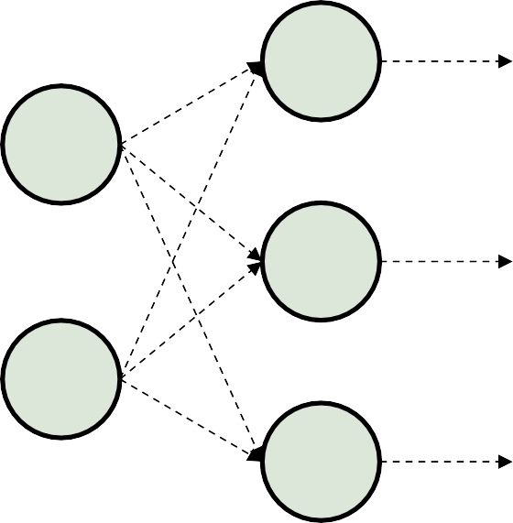
Probability of autoencoder
Decoder
𝒙._{𝟏}
𝒉_{𝟏}
𝒙._{𝟐}
𝒉_{𝟐}
𝒙._{𝟑}

Slide 44
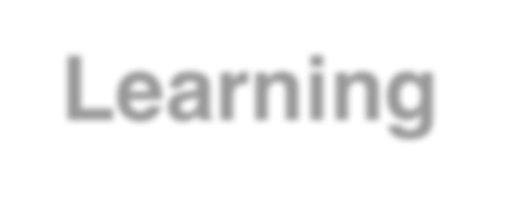

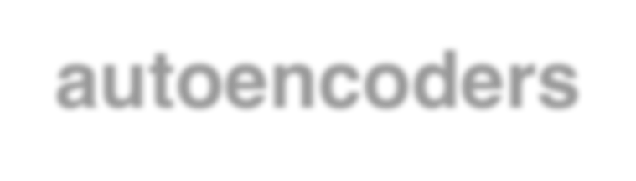
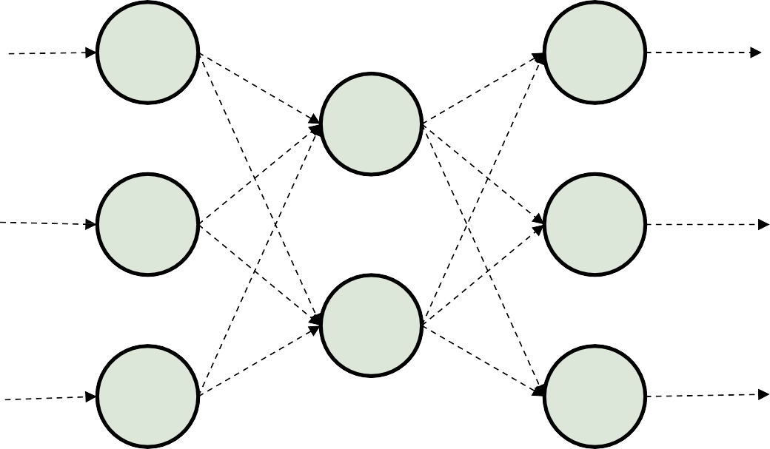
Learning of autoencoders
𝑴 𝑵
𝑴𝑺𝑬 =
Autoencoder with real number as input
-use Mean Square Error (MSE) as loss function
𝟏 𝟏
𝑵 𝑴
𝒏
𝒏 𝟐
@ @(𝒙 − 𝒙. )
𝒎
𝒎
𝒎 𝒏C𝟏
_{𝒙}(𝟏)
_{𝒙}(𝟐)
_{𝒙.}(𝟏)
_{𝒙.}(𝟐)
0.12
0.321
12.8
-2.12
𝒙_{𝟏}
𝒙._{𝟏}
0.23
9.13
0.33
0.37
2.8
2.12
10.11
𝒙_{𝟐}
𝒙._{𝟐}
-1.03
𝒙_{𝟑}
𝒙._{𝟑}
Input 𝒙
Output 𝒙.

Slide 45
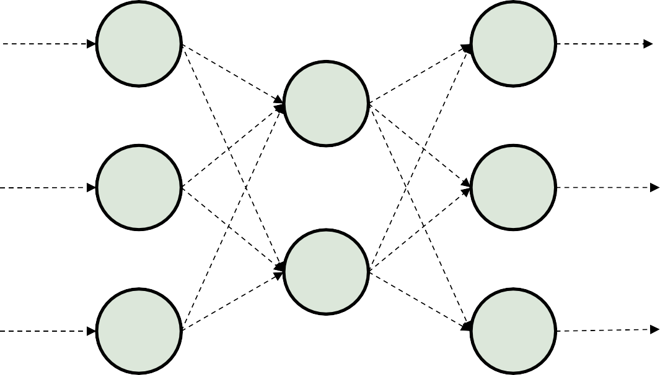
Learning of autoencoders
Autoencoder with binomial/multinomial value as input
- use softmax as output
_{𝒙}(𝟏)
_{𝒙}(𝟐)
_{𝒙.}(𝟏)
_{𝒙.}(𝟐)
0
1
0
1
0
0
𝒙_{𝟏}
𝒙._{𝟏}
0.1
0.8
0.1
0.3
0.4
0.3
𝒙_{𝟐}
𝒙._{𝟐}
𝒙_{𝟑}
𝒙._{𝟑}
Input 𝒙
Output 𝒙.

Slide 46
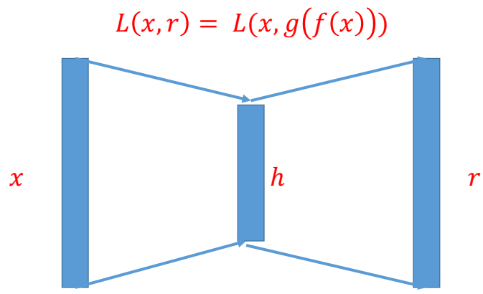
Undercomplete Autoencoders
• Undercomplete Autoencoders are designed to have a hidden layer h, with smaller dimension than input layer x.
• Its designed to extract useful features from data rather than simply copying input to output.
•Training of Undercomplete autoencoder forces it to capture silent features of training data.
• Network must model x in lower dim. space + map latent
space accurately back to input space.
• Encoder network: function that returns a useful, compressed representation of input.

Slide 47
Undercomplete Autoencoders (Other way)
An undercomplete autoencoder is one of the simplest types of autoencoders.
The way it works is very straightforward—
Undercomplete autoencoder takes in an image and tries to predict the same image as output, thus reconstructing the image from the compressed bottleneck region.
Undercomplete autoencoders are truly unsupervised as they do not take any form of label, the target being the same as the input.
The primary use of autoencoders like such is the generation of the latent space or the bottleneck, which forms a compressed substitute of the input data and can be easily decompressed back with the help of the network when needed.

Slide 48
Undercomplete autoencoder and Overcomplete Autoencoder
For Undercomplete autoencoder - output dimension of encoder is smaller than input dimension and vice versa for Overcomplete autoencoder
𝒙_{𝟏}
𝒙._{𝟏}
𝒙_{𝟏}
𝒙._{𝟏}
𝒙_{𝟐}
𝒙._{𝟐}
𝒙_{𝟐}
𝒙._{𝟐}
𝒙_{𝟑}
𝒙._{𝟑}
𝒙_{𝟑}
𝒙._{𝟑}
Undercomplete
Overcomplete

Slide 49
Regularized Autoencoder
Overcomplete autoencoder: coding dimension is equal to or higher than the input dimension. But this again raises the issue of the model not learning any useful features and simply copying the input.
One solution to the above problem is the use of Regularized autoencoder.
When training a regularized autoencoder we need not make it undercomplete. We can choose the coding dimension and the capacity for the encoder and decoder according to the task at hand.
A regularized autoencoder can be nonlinear and overcomplete but still learn something useful about the data distribution.
To properly train a Regularized autoencoder, we choose loss functions that help the model to learn better and capture all the essential features of the input data.

Slide 50
Regularised Autoencoder
Regularized autoencoders: add regularization term that encourages the model to have other properties
• Sparsity of the representation (sparse autoencoder)
• Robustness to noise or to missing inputs (denoising autoencoder)
Therefore Three types of Regularized autoencoder: 1. Sparse Autoencoder
2. Denoising Autoencoder
3. Contractive Autoencoder

Slide 51
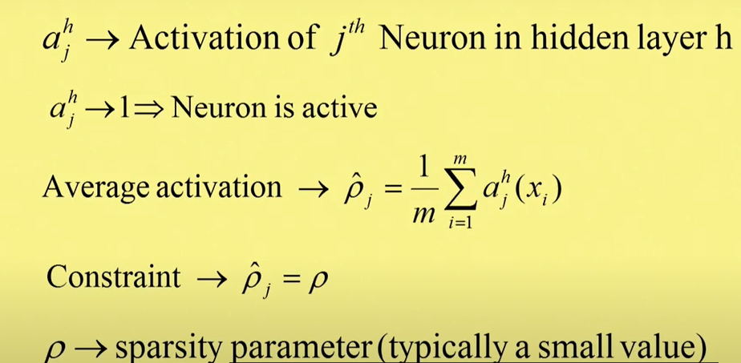
Sparse Autoencoder (IIT Kharagpur.. Prof. Biswas)
Sparsity parameter can be chosen very small typically as 0.2 Or 0.002 based on degree of sparsity required. It controls no of active hidden layer nodes.
No of active nodes in the hidden layer α (directly proportional) sparsity constant.
Silent features of data can be learnt even if no of hidden nodes are more than or equal to no of inputs.
Its done by imposing constraint known as sparsity constraint on hidden layer nodes which will allow only few nodes of network to be active at any given time.
Autoencoder learns encoding and decoding of data using small no of hidden nodes.
Activating few neurons in hidden layer i.e property of sparsity of network is accomplished by introducing Regularization term in loss function.
Assume unipolar sigmoid (Nonlinear) activation
function.
If Xi= ith input vector and there are m no of such vectors
Then avg activation for node j is given as ……..
Using this constraint its possible to introduce a regularization
term. Constraint: Avg activation function of node j = sparsity parameter
If
, Else 0
0.2 or 0.02

Slide 52
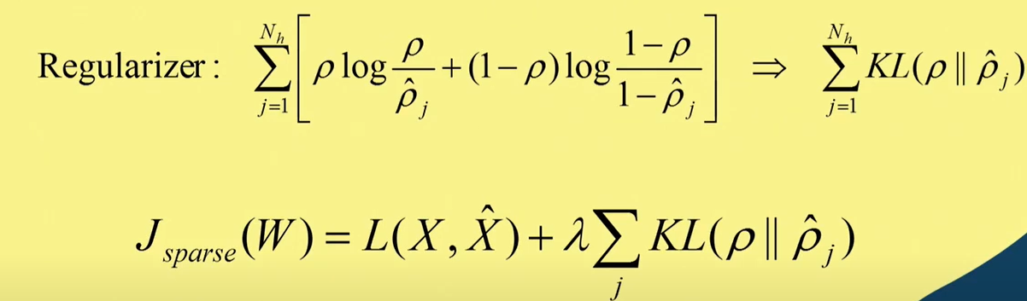
Sparse Autoencoder (IIT Kharagpur.. Prof. Biswas)
Using the constraint Regularisation term can be introduced
Regularization term (on activation function) is KL
divergence between 2 distributions given by ρ and ^ρ.
Nh = No of nodes in the hidden layer.
KL divergence gives distance between two distributions.
Here,
W = weight component.
X = Original input and X^ = output = Reconstructed input
Regularization loss = KL divergence between ρ and ^ρ.
λ = Relative weight between data loss component and Regularization loss component.
Now backpropagation algorithm can be applied to reduce overall loss function.
Total Loss Fun= Data Loss+ Regularization loss

Slide 53
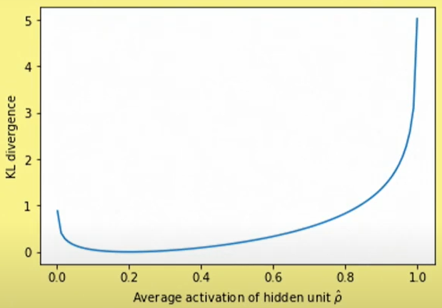
Sparse Autoencoder (IIT Kharagpur.. Prof. Biswas)
Fig shows variation in KL divergence between two
Distributions with average activation function of
hidden unit ^ρ
If ρ = 0.2 and ^ρ = 0.2 then KL divergence = 0.
As difference between ρ and ^ρ increases divergence increases faster.
KL divergence is basically measures distance between two different distributions.
Implications of Introducing KL divergence as regularisation term in overall loss function
It makes very few nodes in the hidden layer to be active for given input features.
For different features some other set of few hidden nodes may be active.
Thus different nodes are activated for different types of features in the input data.

Slide 54
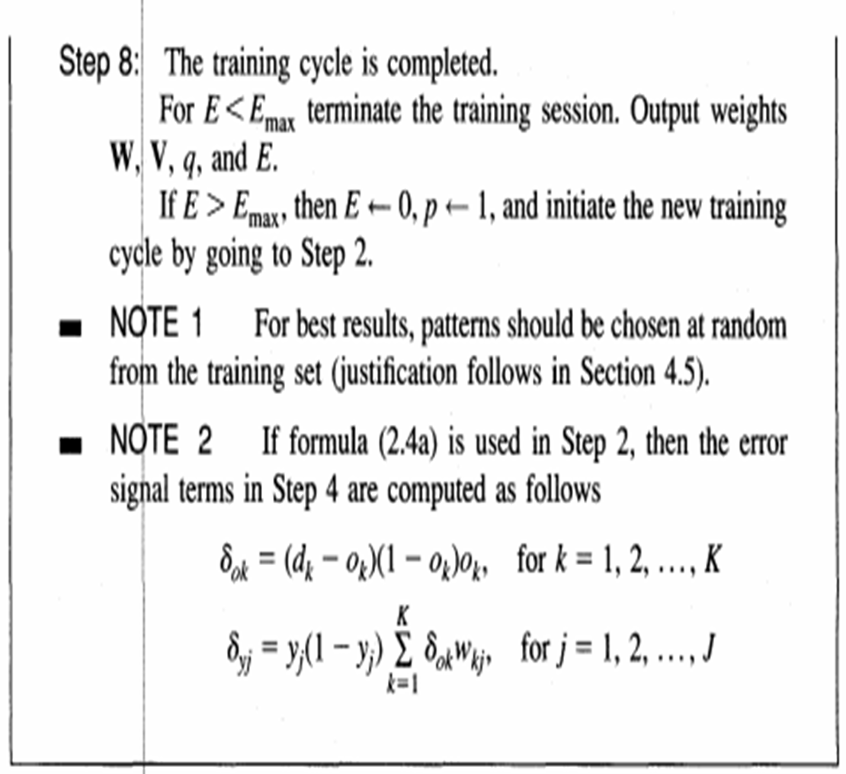
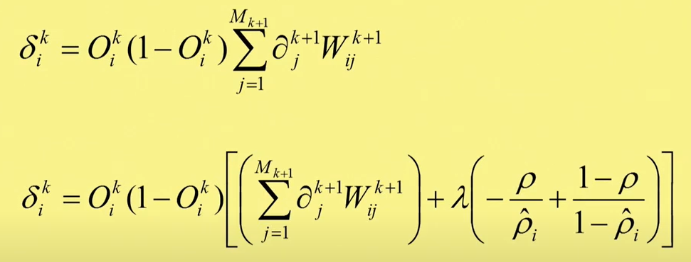
Sparse Autoencoder
(IIT Kharagpur.. Prof. Biswas)
First equation is the back propagation error term in the case of EBPA.
With introduction of KL Divergence this tern gets modified as given in second equation.
The second term needs to be introduced in back propagation error term and remaining EBPA learning remains same.
With introduction of KL divergence, For given input data, he average activation in hidden layer is restricted and few of the nodes in the hidden layer will be active and most of the nodes will be inactive.
For different input features, different set of hidden layer nodes will be active.
Based on silent features of input data particular hidden layer neurons will be activated. Different nodes in the hidden layer neurons will be activated for different types of features in the input. i.e different nodes learn different types of features in the input data. Eg: if a kind of feature k is present in the input data then kth node in the hidden layer will be activated. Same is true for different kind of features.
Thus in Sparse Autoencoder, different nodes in the hidden layer learn different types of features in the input data.
Thus in Sparse Autoencoder, in spite of having more no of hidden nodes as compared to no of input nodes, its still able to learn compressed representation of input data (which is learned by introducing sparsity constraint).

Slide 55


Sparse Autoencoder (Good Fellow)
𝒙 ∶ 𝒊𝒏𝒑𝒖𝒕 𝒅𝒂𝒕𝒂
𝒉 ∶ 𝒄𝒐𝒅𝒆𝒅 𝒅𝒂𝒕𝒂
𝑳 ∶ 𝒍𝒐𝒔𝒔 𝒇𝒖𝒏𝒄𝒕𝒐𝒊𝒏
𝒇 ∶ 𝒆𝒏𝒄𝒐𝒅𝒊𝒏𝒈
𝒈 ∶ 𝒅𝒆𝒄𝒐𝒅𝒊𝒏𝒈
𝛀 ∶ 𝐩𝐞𝐧𝐚𝐥𝐭𝐲 𝐭𝐞𝐫𝐦
𝝀 ∶ 𝐢𝐦𝐩𝐨𝐫𝐭𝐚𝐧𝐜𝐞 𝐨𝐟 𝐜𝐨𝐧𝐬𝐭𝐫𝐚𝐧𝐭
Sparse autoencoders have hidden nodes greater than input nodes. They can still discover important features from the data.
Sparsity constraint is introduced on the hidden layer. This is to prevent output layer copy input data. Sparse autoencoders have a sparsity penalty, Ω(h), a value close to zero but not zero. Sparsity penalty is applied on the hidden layer in addition to the reconstruction error.
L1 regularization……
KL Divergence
Adding a sparsity penalty helps the autoencoder to capture many of the useful features of data and not simply copy it.
Sparse autoencoders take the highest activation values in the hidden layer and zero out the rest of the hidden nodes. This prevents autoencoders to use all of the hidden nodes at a time and forcing only a reduced number of hidden nodes to be used.
As we activate and inactivate hidden nodes for each row in the dataset. Each hidden node extracts a feature from the data.

Slide 56
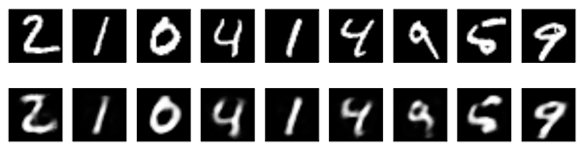
Sparse autoencoder (Good Fellow)
The following is an image showing MNIST digits. The first row shows the original images and the second row shows the images reconstructed by a sparse autoencoder
Advantages
The sparsity constraint in sparse autoencoders helps in filtering out noise and irrelevant features during the encoding process.
These autoencoders often learn important and meaningful features due to their emphasis on sparse activations.
Disadvantages
The choice of hyperparameters play a significant role in the performance of this autoencoder. Different inputs should result in the activation of different nodes of the network.
The application of sparsity constraint increases computational complexity.

Slide 57
Denoising autoencoder (IIT Kharagpur.. Prof. Biswas)
Here instead of feeding input data, corrupted data is given at input and output will be uncorrupted original input data.
The autoencoder should be sensitive enough to the input data so that its able to reproduce input data but it should be insensitive enough to the input data so that it does not remember the input data but is able to generate compressed domain representation of input data.
In other words the auto encoder will learn and remember the silent features of input data instead of remembering whole input data.
That means encoding-decoding scheme learnt by auto encoder should be generalizable . It should not memorize input data.
In case of Denoising auto encoder, its trained with corrupted version of input data and output is expected to be uncorrupted version of original data.
As input and output is different auto encoder can not memorize input data anymore. As a result it learns the vector field that maps input data to a point on a low dimensional manifold.

Slide 58
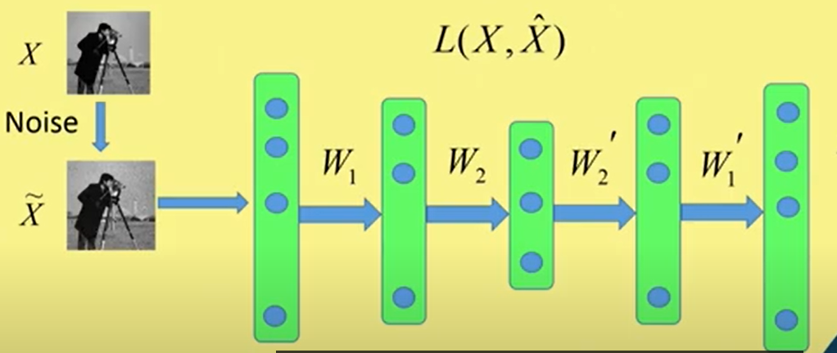


Denoising autoencoder (IIT Kharagpur.. Prof. Biswas)
During back propagation training loss
function to be minimised is
where
X^ = reconstructed data and
X = original data
That means
Encoder
Decoder

Slide 59

Denoising autoencoder
Denoising refers to intentionally adding noise to the raw input before providing it to the network.
Denoising autoencoders create a corrupted copy of the input by introducing some noise. This helps to avoid the autoencoders to copy the input to the output without learning features about the data.
Corruption of the input can be done randomly by making some of the input as zero. Remaining nodes copy the input to the noised input.
Denoising autoencoders must remove the corruption to generate an output that is similar to the input. Output is compared with input and not with noised input. To minimize the loss function we continue until convergence
Denoising autoencoders minimizes the loss function between the output node and the corrupted input.
Denoising helps the autoencoders to learn the latent representation present in the data. Denoising autoencoders ensures a good representation is one that can be derived robustly from a corrupted input and that will be useful for recovering the corresponding clean input.
Denoising is a stochastic autoencoder as we use a stochastic corruption process to set some of the inputs to zero.

Slide 60

Denoising autoencoder
The following image shows how denoising autoencoder works. The second row shows the reconstructed images after the decoder has cleared out the noise.
Advantages
This type of autoencoder can extract important features and reduce the noise or the useless features.
Denoising autoencoders can be used as a form of data augmentation, the restored images can be used as augmented data thus generating additional training samples.
Disadvantages
Selecting the right type and level of noise to introduce can be challenging and may require domain knowledge.
Denoising process can result into loss of some information that is needed from the original input. This loss can impact accuracy of the output.

Slide 61
Contractive Autoencoder
Working principle: For similar inputs the compressed domain representation should also be similar.
To achieve this, its required to restrict the variation in hidden layer neuron activation w.r.t input data to be small.
That means for similar inputs, similar neurons in the hidden layer should get activated.
Thus auto encoder learns to contract the neighbourhood of inputs to small neighbourhood of outputs.
Similar inputs are encoded in the similar way and also decoded outputs are very similar.
It ensures that at the input or in a small neighbourhood at the input will get contracted to a very small neighbourhood at the output.
Regularization on the activation to be imposed in contractive auto encoder is that variation of hidden layer activation should be small w.r.t the input data.

Slide 62

Contractive Autoencoder
Regularisation can be minimisation of Frobenius norm of Jacobian matrix of the activation functions in the Detector.
Frobenius norm of a matrix: If matrix is A, then Frobenius norm is aij^2 where aij th element of the Matrix A.
Square root of summation of all these elements is Frobenius norm.
Regularisation term can be squared Frobenius norm of the Jacobian matrix.
Jacobian matrix: It is gradient of loss function.
Loss function is scalar, weighs are vectors then gradient of scalar function w.r.t vector, the gradient becomes Vector.
Here, for every hidden layer node, input is a vector and for multiple nodes in the hidden layer, the activations taken together are also vectors. Gradient of these vectors w.r.t input vector is gradient of scalar w.r.t. vector becomes vector and gradient of vector w.r.t vector becomes matrix.

Slide 63

Contractive Autoencoder
Jacobian matrix captures variation of different components of output vector w.r.t input vector.
In this case if there are N no. of nodes in the hidden layer, there will be N no of activation values, one activation value of every hidden layer node and if input data vector is of m dimensional then Jacobian matrix becomes as in Figure. Here a1 is the activation of first node in the hidden layer for input vector X.
Thus first row is gradient of output of the first node in the hidden layer w.r.t input vector and so on.
Regularisation term becomes squared Frobenius norm of Jacobian matrix.
Represents components of Jacobian matrix.
Back propagation algorithm should try to minimize data and regularisation loss.
Regularisation term ensures that upon
completion of training, variation of
activation functions in the hidden layer
w.r.t input will be minimum.

Slide 64

Applications : In painting
For some parts of the image if information is missing or corrupt then with the help of autoencoder
it can be repaired ss shown in the figure.

Slide 65
Applications : Abnormality detection
Many a times for security camera its required to detect an abnormal event.
Suppose on the footpath of road only pedestrians should move and not the car.
Train the autoencoder with images of only pedestrians can move.
Now if car is captured in the image, autoencoder can not reconstruct the car properly.
For region where car is there, reconstruction Error will be large.
Thus in the output image wherever reconstruction error is large, in that region abnormal activity is taking place.

Slide 66

Applications
Denoising: input clean image + noise and train to reproduce the clean image.
Data denoising and dimensionality reduction for data visualization are tow major practical applications of Autoencoders.
Dimensionality Reduction/Data compression: Make high-quality, low-dimension representation of data.

Slide 67


Applications
Water mark removal
Image colorization: input black and white and train to produce color images

Slide 68
Convolutional Neural Network

Slide 69




Convolution In 2-D
CNN depends on the operation of convolution, Let us understand the convolution operation.
Kernal 1- It gives derivative in the vertical direction.
Kernal 2- This gives derivative in horizontal direction.
When input image is convolved with these Kernals,
you get a particular type of output as shown below.
Original image, Derivative in the vertical the horizontal direction
Output of convolution operation
Output is combination of both vertical And horizontal derivatives which gives image features
If the derivative is taken in the vertical direction All discontinuities in the horizontal direction will be visible lines and vice-versa

Slide 70

Convolution In 2-D
Difference between weighted sum of elements of first row and weighted sum of elements In the third row. It performs differential operation in vertical direction, Thus it helps in finding horizontal edges in an image.
Original image, Derivative in the vertical the horizontal direction
Difference between weighted sum of elements of first column and weighted sum of elements In the third column. It performs differential operation in horizontal direction, Thus it helps in finding vertical edges in an image
The output images are called feature maps. They help in recognition of objects in an image.

Slide 71

Combination of two images gives an image that contains vertical and horizontal edges in the image.

Slide 72

Convolution In 2-D
These two outputs give silent features of structural information in the image.
In the uniform regions of an image, there is no structure and the, output will be zero i.e black part.
In the areas of an image, where structural information is present, the output will be features

Slide 73

Convolutional Neural Network
Convolutional neural networks. Sounds like a weird combination of biology and maths with a little CS sprinkled in, but these networks have been some of the most influential innovations in the field of computer vision.
In deep learning, a convolutional neural network (CNN/ConvNet) is a class of deep neural networks, most commonly applied to analyze visual imagery.

Slide 74
Convolutional Neural Network
A fundamental goal of using CNN with images is to remove cumbersome and ultimately limiting feature selection process.
A convolutional neural network is a feed-forward neural network that is generally used to analyze visual images by processing data with grid-like topology. It’s also known as a ConvNet. A convolutional neural network is used to detect and classify objects in an image.
They can identify faces, individuals, street signs and many other aspects of visual data. They are good at text and sound analysis.
CNN works well with self driving cars, drones, robotics and treatment for visually impaired.
They are good at building positions and rotation invariant features from raw image data.
They help in building a more robust feature space based on signal.

Slide 75

Neural Network
Below is a neural network that identifies two types of flowers: Orchid and Rose.

Slide 76

Convolutional Neural Network

Slide 77


Representation of image in CNN
In CNN, every image is represented in the form of an array of pixel values.

Slide 78
Architecture of CNN
A convolution neural network has multiple hidden layers that help in extracting information from an image. The four important layers in CNN are:
Convolution layer
ReLU layer
Pooling layer
Fully connected layer

Slide 79


Convolution Layer
The convolution layer is the core building block of the CNN. It carries the main portion of the network’s computational load.
This layer performs a dot product between two matrices, where one matrix is the set of learnable parameters otherwise known as a kernel, and the other matrix is the restricted portion of the receptive field. The kernel is spatially smaller than an image but is more in-depth. This means that, if the image is composed of three (RGB) channels, the kernel height and width will be spatially small, but the depth extends up to all three channels.

Slide 80

Convolution operation
This will yield an output volume of size Wout x Wout x Dout.

Slide 81


Slide 82

Padding on the input volume with zeros in such way that the conv layer does not alter the spatial dimensions of the input

Slide 83

Stride and Padding
During the forward pass, the kernel slides across the height and width of the image-producing the image representation of that receptive region. This produces a two-dimensional representation of the image known as an activation map that gives the response of the kernel at each spatial position of the image. The sliding size of the kernel is called a stride.
If we have an input of size W x W x D and Dout number of kernels with a spatial size of F with stride S and amount of padding P, then the size of output volume can be determined by the following formula:
Filter size: It can be 3*3, 5*5, 7*7. It is advisable to keep small size filter.
Stride: The distance between consecutive application of filter on input image/data.
It has suggested to keep stride one to capture all useful information in the feature map.
Zero padding: It helps in keeping the volume of input and output same.

Slide 84

Convolution example without zero padding

Slide 85

Convolution example without zero padding

Slide 86
Try with zero padding
0 | 0 | 0 | 0 | 0 | 0 | 0
0 | 1 | 1 | 1 | 0 | 0 | 0
0 | 0 | 1 | 1 | 1 | 0 | 0
0 | 0 | 0 | 1 | 1 | 1 | 0
0 | 0 | 0 | 1 | 1 | 0 | 0
0 | 0 | 1 | 1 | 0 | 0 | 0
0 | 0 | 0 | 0 | 0 | 0 | 0
2 | 3 | 3 | 1 | 1
1 | 4 | 3 | 4 | 1
1 | 2 | 5 | 3 | 2
1 | 2 | 3 | 4 | 1
0 | 2 | 2 | 2 | 1
1 | 0 | 1
0 | 1 | 0
1 | 0 | 1
*
=
Zero padding: It helps in keeping the volume of input and output same.

Slide 87
Motivation behind Convolution
Convolution leverages three important ideas that motivated computer vision researchers: sparse interaction, parameter sharing, and equivariant representation. Let’s describe each one of them in detail.
Trivial neural network layers use matrix multiplication by a matrix of parameters describing the interaction between the input and output unit. This means that every output unit interacts with every input unit. However, convolution neural networks have sparse interaction. This is achieved by making kernel smaller than the input e.g., an image can have millions or thousands of pixels, but while processing it using kernel we can detect meaningful information that is of tens or hundreds of pixels. This means that we need to store fewer parameters that not only reduces the memory requirement of the model but also improves the statistical efficiency of the model.
If computing one feature at a spatial point (x1, y1) is useful then it should also be useful at some other spatial point say (x2, y2). It means that for a single two-dimensional slice i.e., for creating one activation map, neurons are constrained to use the same set of weights. In a traditional neural network, each element of the weight matrix is used once and then never revisited, while convolution network has shared parameters i.e., for getting output, weights applied to one input are the same as the weight applied elsewhere.
Due to parameter sharing, the layers of convolution neural network will have a property of equivariance to translation. It says that if we changed the input in a way, the output will also get changed in the same way.

Slide 88

ReLU Layer
The Rectified Linear Unit (ReLU) has become very popular in the last few years. It is hard max function which serves to introduce non linearity in the network. It computes the function ƒ(κ)=max (0,κ). In other words, the activation is simply threshold at zero.
It replaces all negative values in feature map to zero
In comparison to sigmoid and tanh, ReLU is more reliable and accelerates the convergence by six times.
Unfortunately, a con is that ReLU can be fragile during training. A large gradient flowing through it can update it in such a way that the neuron will never get further updated. However, we can work with this by setting a proper learning rate.

Slide 89

Pooling Layer
Pooling makes the output invariant to small translations.
Pooling layer is introduced in order to speed up the computation in CNN architecture.
It reduces dimensionality of feature map, computations and hence increases speed of network.
The pooling layer replaces the output of the network at certain locations by deriving a summary statistic of the nearby outputs. This helps in reducing the spatial size of the representation, which decreases the required amount of computation and weights. The pooling operation is processed on every slice of the representation individually.
There are several pooling functions such as the average of the rectangular neighborhood, L2 norm of the rectangular neighborhood, and a weighted average based on the distance from the central pixel. However, the most popular process is max pooling, which reports the maximum output from the neighborhood.
If we have an activation map of size W x W x D, a pooling kernel of spatial size F, and stride S, then the size of output volume can be determined by the following formula:
This will yield an output volume of size Wout x Wout x D.
In all cases, pooling provides some translation invariance which means that an object would be recognizable regardless of where it appears on the frame.

Slide 90

Pooling (Down Sampling)

Slide 91

Types of Pooling

Slide 92
Fully Connected Layer
Neurons in this layer have full connectivity with all neurons in the preceding and succeeding layer as seen in regular FCNN. This is why it can be computed as usual by a matrix multiplication followed by a bias effect.
The FC layer helps to map the representation between the input and the output.
It helps for decision and classification purpose. The weights undergo training using back propagation algorithm. Its output will be result of classification.

Slide 93
ANN Vs CNN
ANN | CNN.
Every neuron output in the previous layer is connected to every neuron n the next layer. As a result connectivity is dense and no of parameters are more. | Every node in convolution layer receives input from limited no of nodes in the previous layer. As a result connectivity is sparse and no of parameters are less.

Slide 94


Slide 95
Convolutional Neural Networks for Self-Driving Cars
Several companies, such as Tesla and Uber, are using convolutional neural networks as the computer vision component of a self-driving car.
A self-driving car’s computer vision system must be capable of localization, obstacle avoidance, and path planning.
Let us consider the case of pedestrian detection. A pedestrian is a kind of obstacle which moves. A convolutional neural network must be able to identify the location of the pedestrian and extrapolate their current motion in order to calculate if a collision is imminent.
A convolutional neural network for object detection is slightly more complex than a classification model, in that it must not only classify an object, but also return the four coordinates of its bounding box.
Furthermore, the convolutional neural network designer must avoid unnecessary false alarms for irrelevant objects, such as litter, but also take into account the high cost of mis categorizing a true pedestrian and causing a fatal accident.
A major challenge for this kind of use is collecting labeled training data. Google’s Captcha system is used for authenticating on websites, where a user is asked to categorize images as fire hydrants, traffic lights, cars, etc. This is actually a useful way to collect labeled training images for purposes such as self-driving cars and Google Street View.

